Slide 1
No Silver Bullets
Essence and Accidents of
Software Engineering
FREDERICK P. BROOKS, JR., 1987
Based on presentations by
F.P Brooks

Slide 2

The Software Werewolf
Software is like a werewolf—it looks normal until the moon comes out and it turns into a monster
  Missed deadlines
  Blown budgets
  Buggy software
We want the silver bullet to kill the
monster
  something to make software costs drop as
  rapidly as computer hardware costs do.

Slide 3
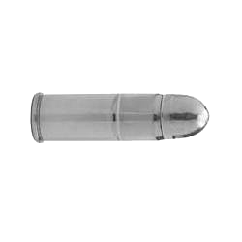
There Is No Silver Bullet!
“As we look to the horizon of a decade hence, we see no silver bullet.
There is no single development, in either
essence, technology or in management technique,
that by itself promises even one order-of-magnitude improvement in productivity, in reliability, in simplicity”

Slide 4
Essential vs. Accidental Difficulties
Essential: a characteristic of software
  Difficulties inherent in the nature of software
  Data sets, relationships among them, algorithms, and function invocation
  Inherent properties of the essence of modern software system:
  Complexity, Conformity, Changeability, Invisibility
Accidental: a problem in today’s production methods
  Difficulties related to the actual production process.
  Note: This doesn’t mean “by chance”!

Slide 5
Complexity
No two parts are alike
Huge number of states
Complexity grows nonlinearly with size
Can’t know the whole domain, process, or system
Unlike other disciplines, we can’t abstract away the complexity because it is essential
  Math, physics: complexities ignored in the models were not
  the essential properties of the phenomena.
Introduces technical and managerial
problems leading to unreliability
Complexity ➔
Software Size ➔

Slide 6
“Software has order of magnitude more states than "computers
How many paths?
loop < 20 X
There are about
10¹⁴ (~5²⁰)
possible paths!
If we execute one test per millisecond, it would take 3,170 years to test this program!!

Slide 7
Consequences of Complexity
Communication overhead: cost overruns, schedule delays
Large number of states: unreliability
  overview is hard
  hard to find and control all the loose ends.
  creates a tremendous learning and understanding burden
Complex function: poor usability
Complex structure: poor maintainability

Slide 8
Conformity
Software development lacks unifying rules and theories.
  man made not God made.
Software must conform to arbitrary limitations
  imposed by humans (e.g. business rules) institutions and systems
Software arrives late in system design
Software viewed as most changeable
It’s hard to plan for arbitrary changes that will
occur late in development

Slide 9

Changeability
Software is easier to change than hardware or cars
Changes during development
Changes after deployment
New features
Software lives longer than hardware
Conform to new vehicles of opportunity (computers, displays etc..)
People underestimate difficulties of change

Slide 10


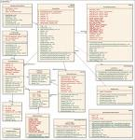
Invisibility
The code is invisible and unvisualizable
  Software reality not embedded in space: no ready geometric representation.
Structure is terribly complex
Structure is hidden
There’s only the external input/output view
silicon chips have diagram
Buildings have plans
UML class

Slide 11
Accidental Difficulties Already Solved
High level languages
  Powerful stroke for software productivity, reliability, & simplicity
  Removed the low level complexities
  Benefits of further improvement is limited
Time sharing
  Increased turnaround time and productivity of programmer
  Improvement is not as much as that of high-level language
  System response time is no longer an issue
Integrated programming environments
  Use of libraries, unified file formats, pipes, filters etc

Slide 12
Is There Any Hope? Yes!
“A disciplined, consistent effort to develop,
propagate, and exploit these innovations
should indeed yield an order-of-magnitude
improvement. There is no royal road, but
there is a road.”
Technical developments that are most often advanced as
potential silver bullets
  Ada & High Level Languages Advances.
  OOP
  AI
    Expert Systems
  Etc.

Slide 13

Programming Then and Now (~40 years perspective)
method of those days:
  discover some requirements,
  code a little,
  discover more requirements,
  code a little more,
  etc, until the coding was done;
  test the whole thing,
  discover bugs or new requirements,
  code some more, etc.
Nowadays, we follow more systematic methods. However, the basic feelings have not changed.
Basically,
programming felt like skiing down a narrow downhill valley with an
avalanche following me down the hill and gaining on me.

Slide 14
The Search for a Silver Bullet
Brooks:
The essence is what the software does and the accidents are the technology by which the software does the essence or by which the software is developed.
  That is, the requirements are the essence, while the language, tools, and methods used are the accidents.
what is so difficult about understanding requirements?
  it should be possible to sit down with the customer and users, ask a few questions, understand the answers, and then synthesize a complete requirements speciﬁcation.

Slide 15
Requirements Change
Two things are known about requirements:
They will change.
  Software will always have to be modiﬁed, to capture the changed requirements.
  There ain’t no way to stop change of requirements .
They will be misunderstood.
  Software will always have to be modiﬁed, to capture the changes imposed by better understanding, as the misunderstandings are discovered.

Slide 16

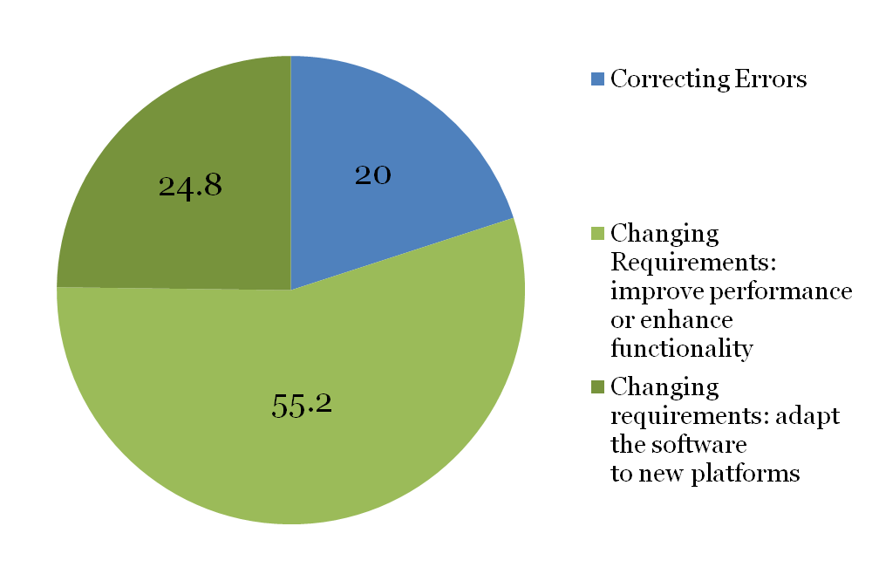
Maintenance of application software
(Bennett Lientz and Burton Swanson ‘78)

Slide 17
Bottom line (by Berry)
I no longer get excited over any new language, development model, method, tool, or environment that is supposed to improve programming…
…The most important work is addressing requirements, changes, and the psychology and sociology of programming

Slide 18
Summary :Things To Try
Reuse: “buy, don’t build”
Requirements improvement and rapid prototyping
Incremental development: (“grow don’t build”)
Better SE training : grow “great designers”
  “My first proposal is that each software organization must determine and proclaim that great designers are as important to its success as great managers are, and that they can be expected to be similarly nurtured and rewarded. Not only salary, but the perquisites of recognition-office size, furnishings, personal technical equipment, travel funds, staff support-must be fully equivalent.”
Multiple coordinated techniques
Future Software Engineers

